Slide 1
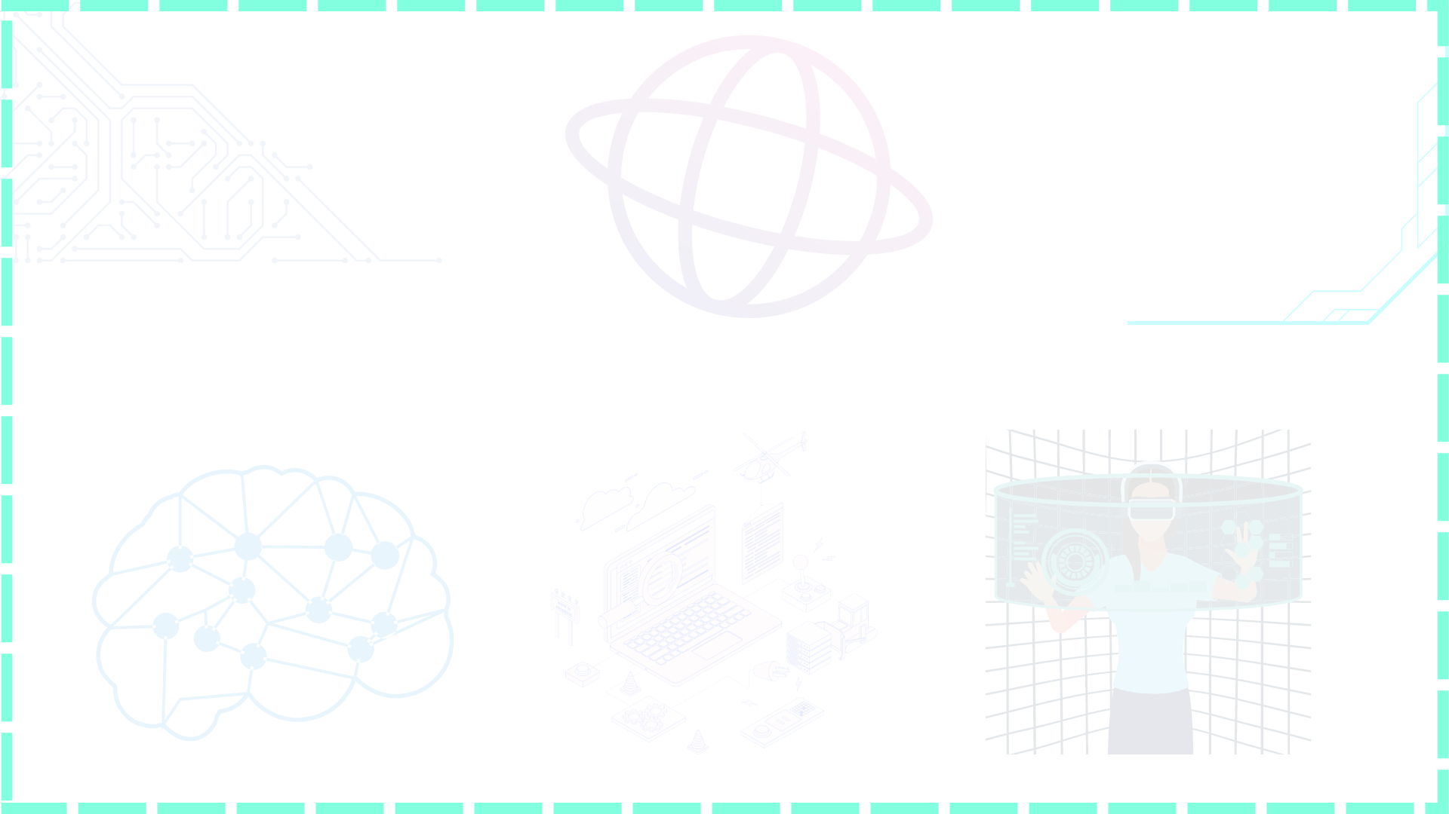
Microservices Tutorial
With Spring Boot

Slide 2
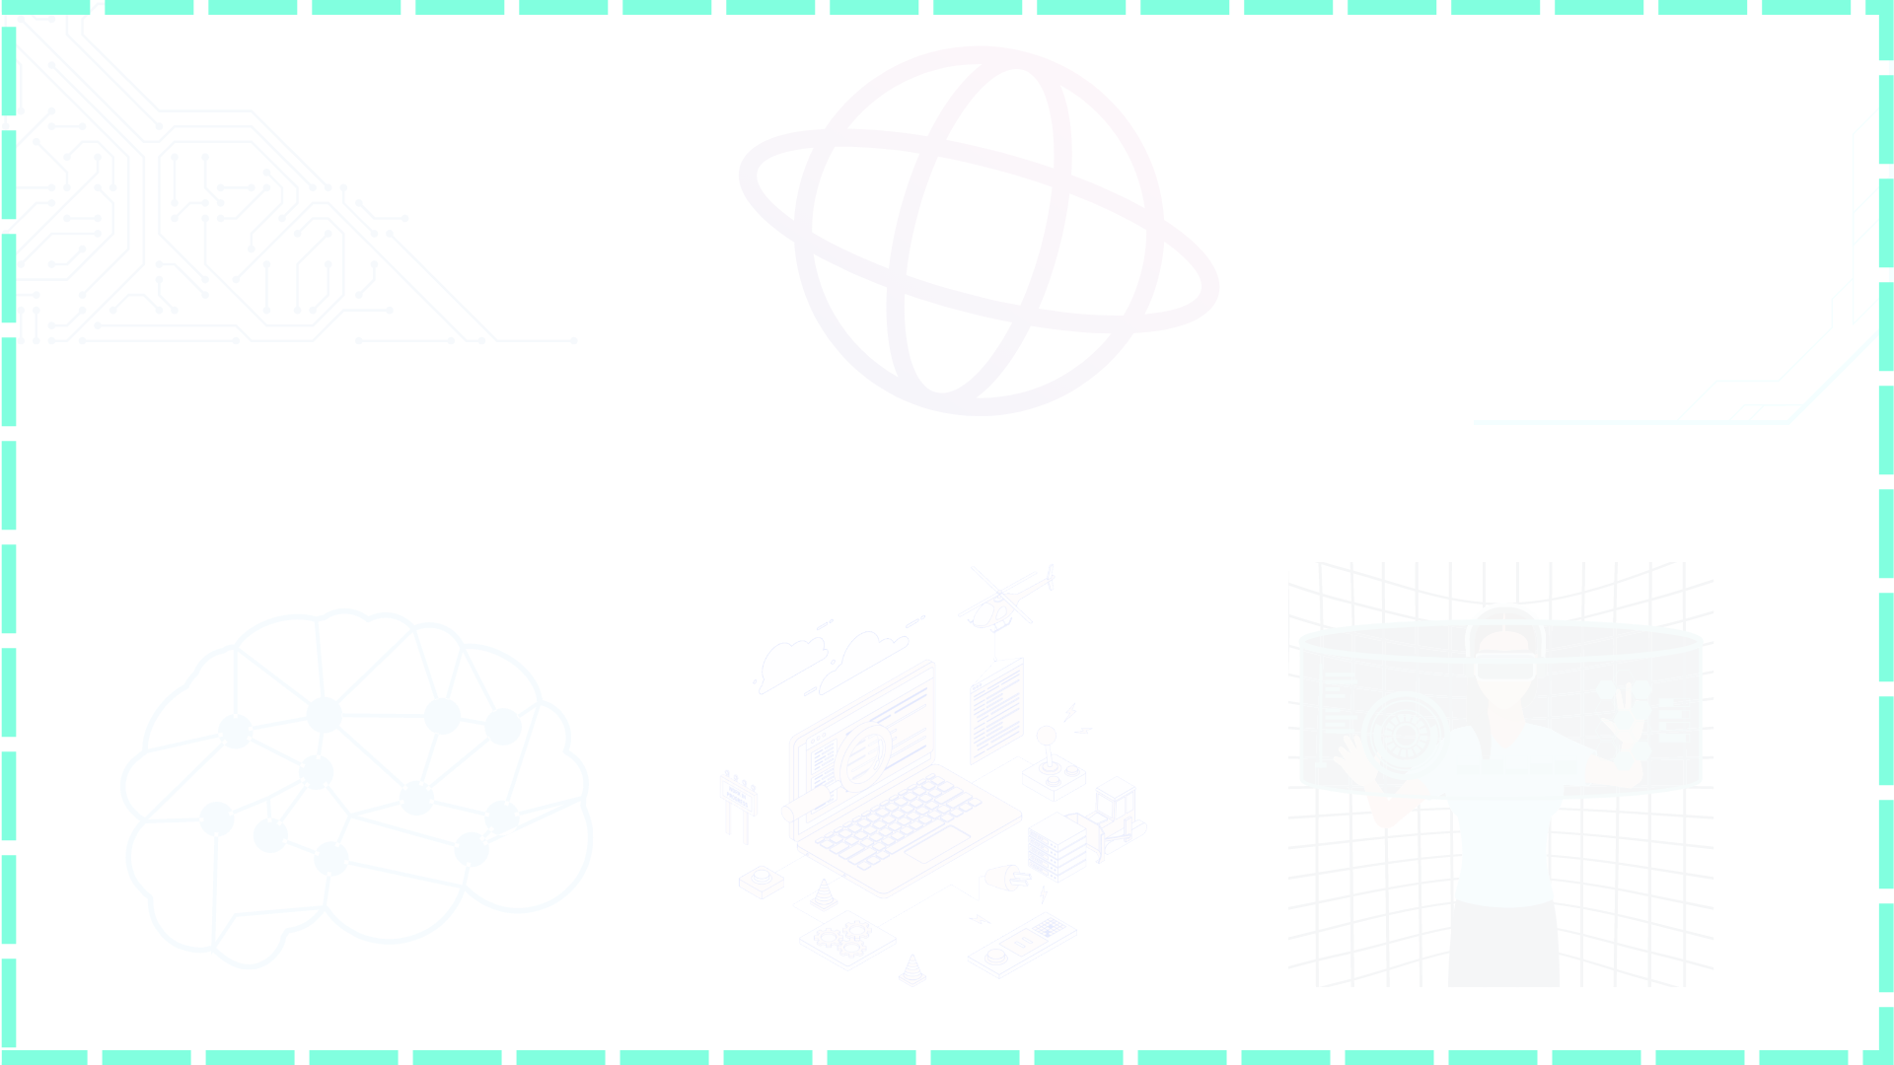

Prerequisite for Microservices Tutorial
Spring Boot
Project using Monolithic Architecture
Smart Contact manager
Exam Portal
Blog Application

Slide 3
Before Microservices
Monolithic architecture: multiple components are combined in single large app.
Single Code Base
Deployed in single bundle
Change in one service then whole app is redeployed
Building problem: developers has to communicate
Problem in scale
Cumbersome over time
Product
Users
Order
Payment
Shipment
Cart
Application using Monolithic

Slide 4
Microservices
Large apps are divide into small parts
Different codebase
Each module managed independently
Different tech stack
Handling microservices is complex
Product
Users
Communicate using Rest APIS
Order
Payment
Microservices

Slide 5

OKTA Auth
Hotel Service
DB1
API Gateway
User Service
Client
DB2
Config Service
Github
Rating Service
DB3
Service Registry

Slide 6
Service Registry
http:/192.168.56.01:8080/
Eureka Client
User Service
Eureka Server
Service Registry
http:/192.168.56.02:8080/
Rating Service
Registered
http:/192.168.56.03:8080/
Hotel Service
Track all the information of services
http://service-name/

Slide 7
Lets start building microservices
Rating Service
User Service
Request
Hotel Service

Slide 8
Request user with userid:
UserService
HotelService
RatingService
ServiceRegistry
Registered

Slide 9
Feign Client
The Feign is a declarative HTTP web client developed by Netflix.
If you want to use Feign, create an interface, and annotate it.

Slide 11
OKTA Auth
Hotel Service
DB1
API Gateway
User Service
Client
DB2
Config Service
Github
Rating Service
DB3
Service Registry

Slide 12
Config Server

Slide 13
Fault Tolerance
HotelService
Client
API Gateway
UserService
HotelService

Slide 14
Fault Tolerance
UserService
Client
API Gateway
RatingService
HotelService

Slide 15
Rate Limiter
This functionality allows limiting access to some service.
Rate Limiter make services highly available by limiting the number of calls we could process in specific windows.
Security
Performance

Slide 16
Security with OKTA
OKTA Auth
Hotel Service
DB1
API Gateway
User Service
Client
DB2
Config Service
Github
Rating Service
DB3
Service Registry

Slide 17
Security with OKTA

Slide 18
Rating Service
User Service
Request
Hotel Service

